Slide 1
Project 7 Android Face recognition
Raffaele Zippo
Enrico Meloni

Slide 2
Summary
Android implementation of face recognition using OpenCV
Face detection with Haar Cascade Classifier
Face features extracted using VGG2
Classification performed with weighted kNN
User interface
Live face recognition
View database contents
Add identities
From pictures or videos
From faces collected during live recognition
With optional clustering

Slide 3
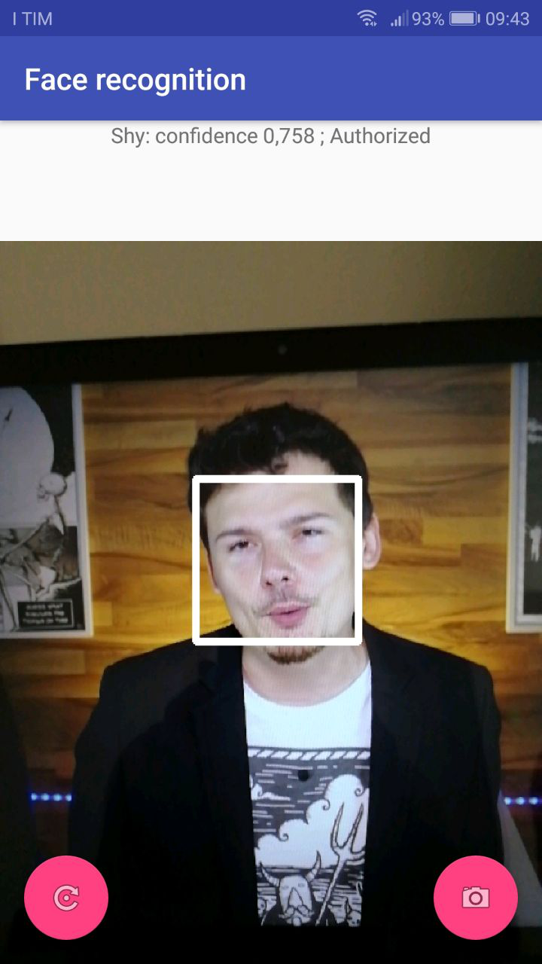
Main activity: live face recognition
Camera feed shows detected faces with boxes
Labeling is shown in the textbox
To improve performance, the two operations are independent and run at their best rates
Distinction between unknown and unclassified
In both cases the face is recorded to database

Slide 4
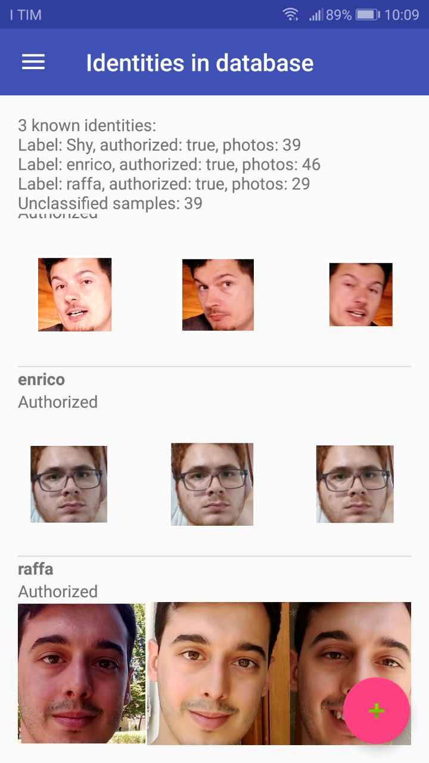
Identity view activity
Display the current state of the database
Database utils
Import/export
Clear

Slide 5
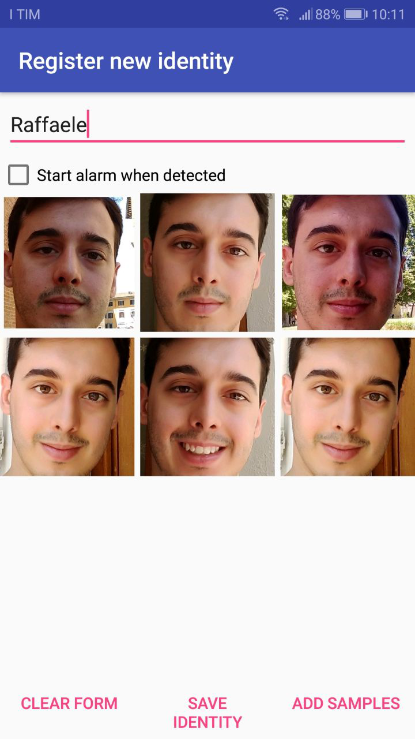
Add identity activity
Interface to add a new identity to the database
Can add samples from multiple sources
Pictures and videos from gallery
Pictures and videos from camera
Unclassified faces from live face recognition
Can be used to add samples to an already existing identity

Slide 6
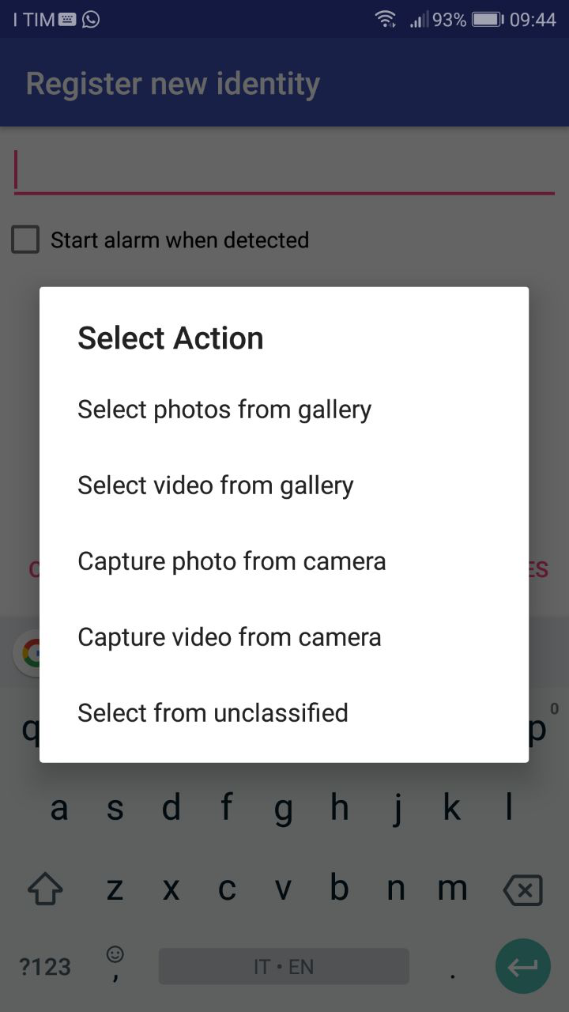
Add identity activity
Interface to add a new identity to the database
Can add samples from multiple sources
Pictures and videos from gallery
Pictures and videos from camera
Unclassified faces from live face recognition
Can be used to add samples to an already existing identity

Slide 7
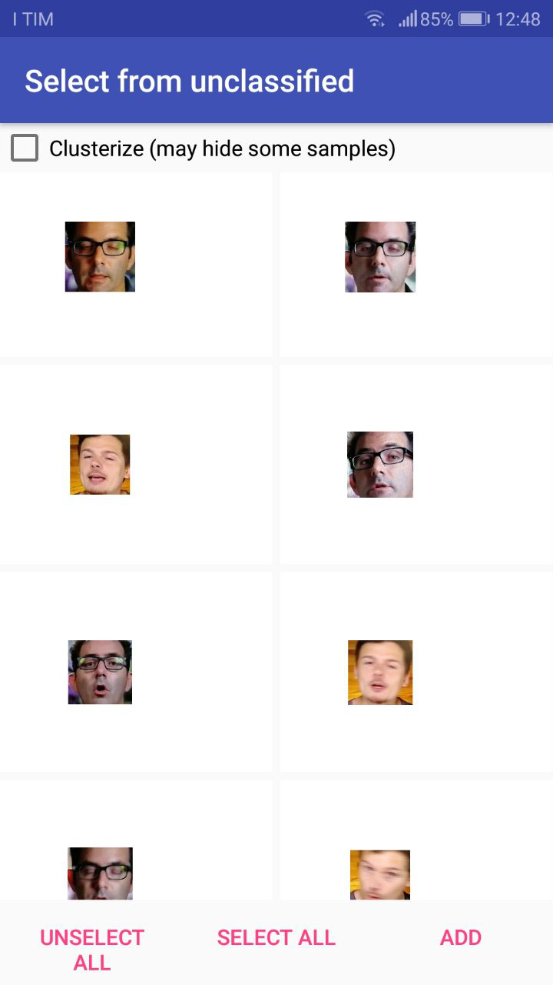
Select from unclassified activity
Shows unclassified faces collected during live face recognition
Which can be selected to create a new identity
Optional clustering
Hides non-clustered samples
Based on DBSCAN

Slide 8
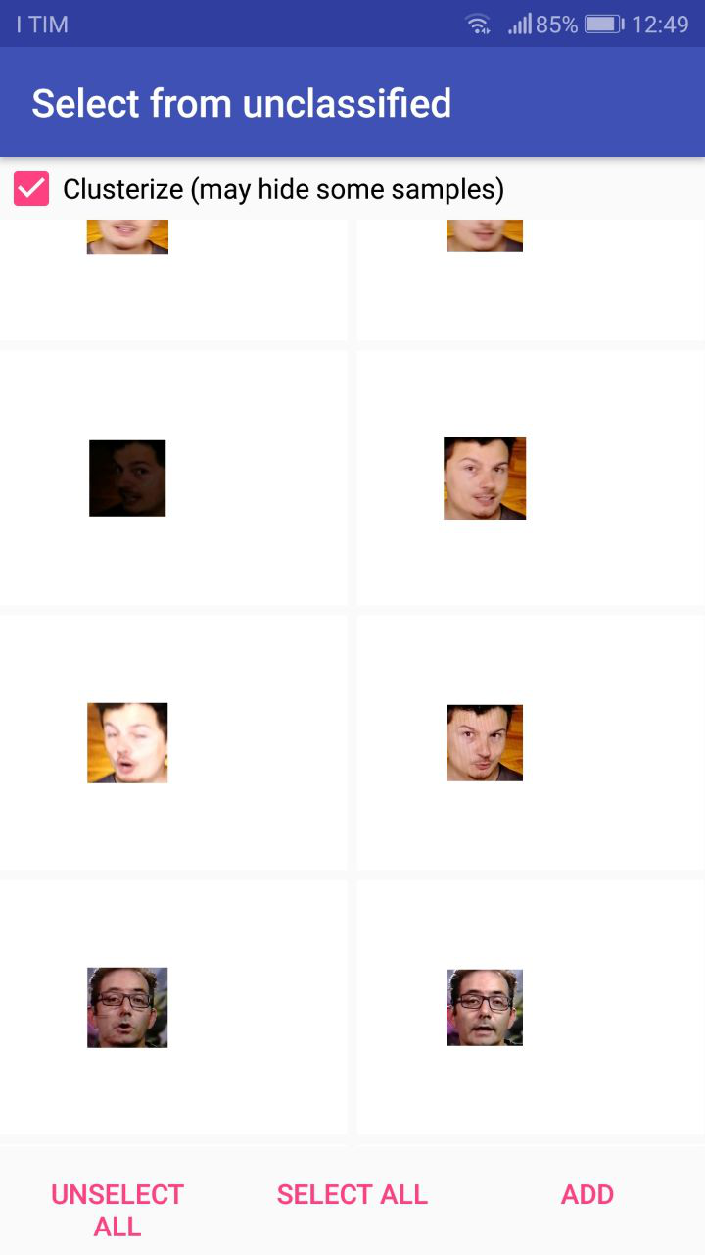
Select from unclassified activity
Shows unclassified faces collected during live face recognition
Which can be selected to create a new identity
Optional clustering
Hides non-clustered samples
Based on DBSCAN

Slide 9
Implementation overview
Implemented on Android using Java
Using OpenCV for Android library
Live camera feed implemented with Camera2 APIs
DBSCAN implementation from Apache Math Commons library
Object-based face database serialized to internal memory when modified

Slide 10
Live face recognition pipeline
Camera
Detection with Haar Cascade
No faces
Faces
Draw to screen
Feature extraction & classification
~5 fps
Draw boxes around faces
~30 fps
Print to screen
Independent flows

Slide 11
Live demo

